Slide 1
AMAZON WEB SERVICES

Slide 2
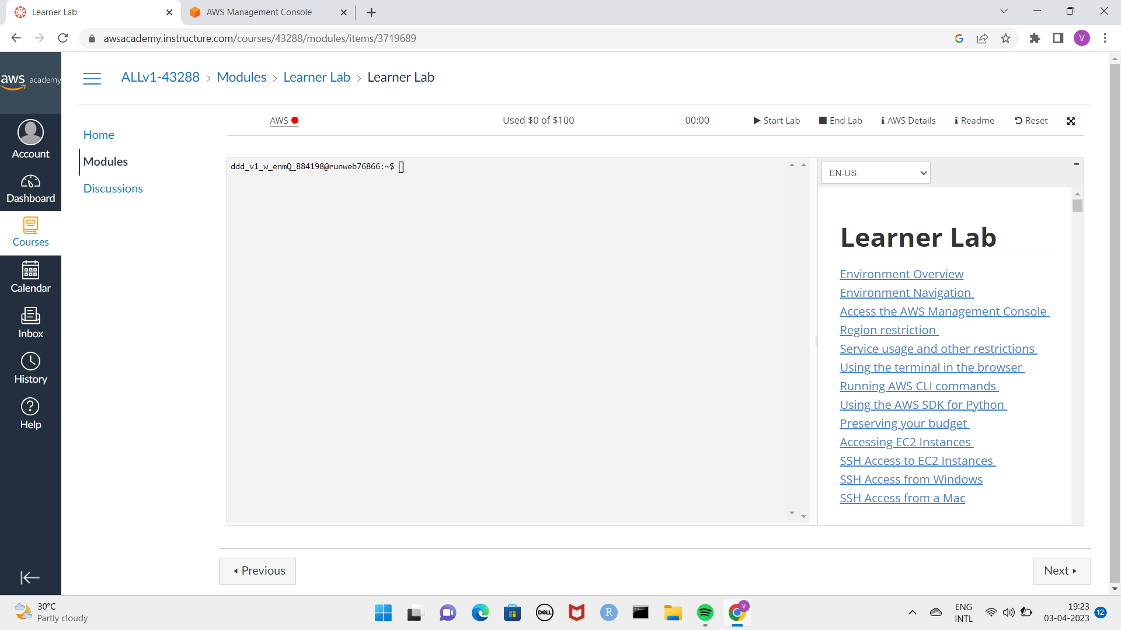
Launching EC2 instance
To launch an EC2 instance we have to login into the AWS academy student portal.
If you are a student the organization we give you access to learners lab .
Open the learners lab and click on modules and then click on leaner lab the site will open as shown in figure below.
Read all the instructions given in right side of the sand box and then click on start lab ,when the red colour turns into green colour click on the word AWS a new tab of AWS management close will appers.
Search of EC2 service at the service bar if not default visible and select that.
Check the region it should be us east-1 or any other region of your choice.

Slide 3
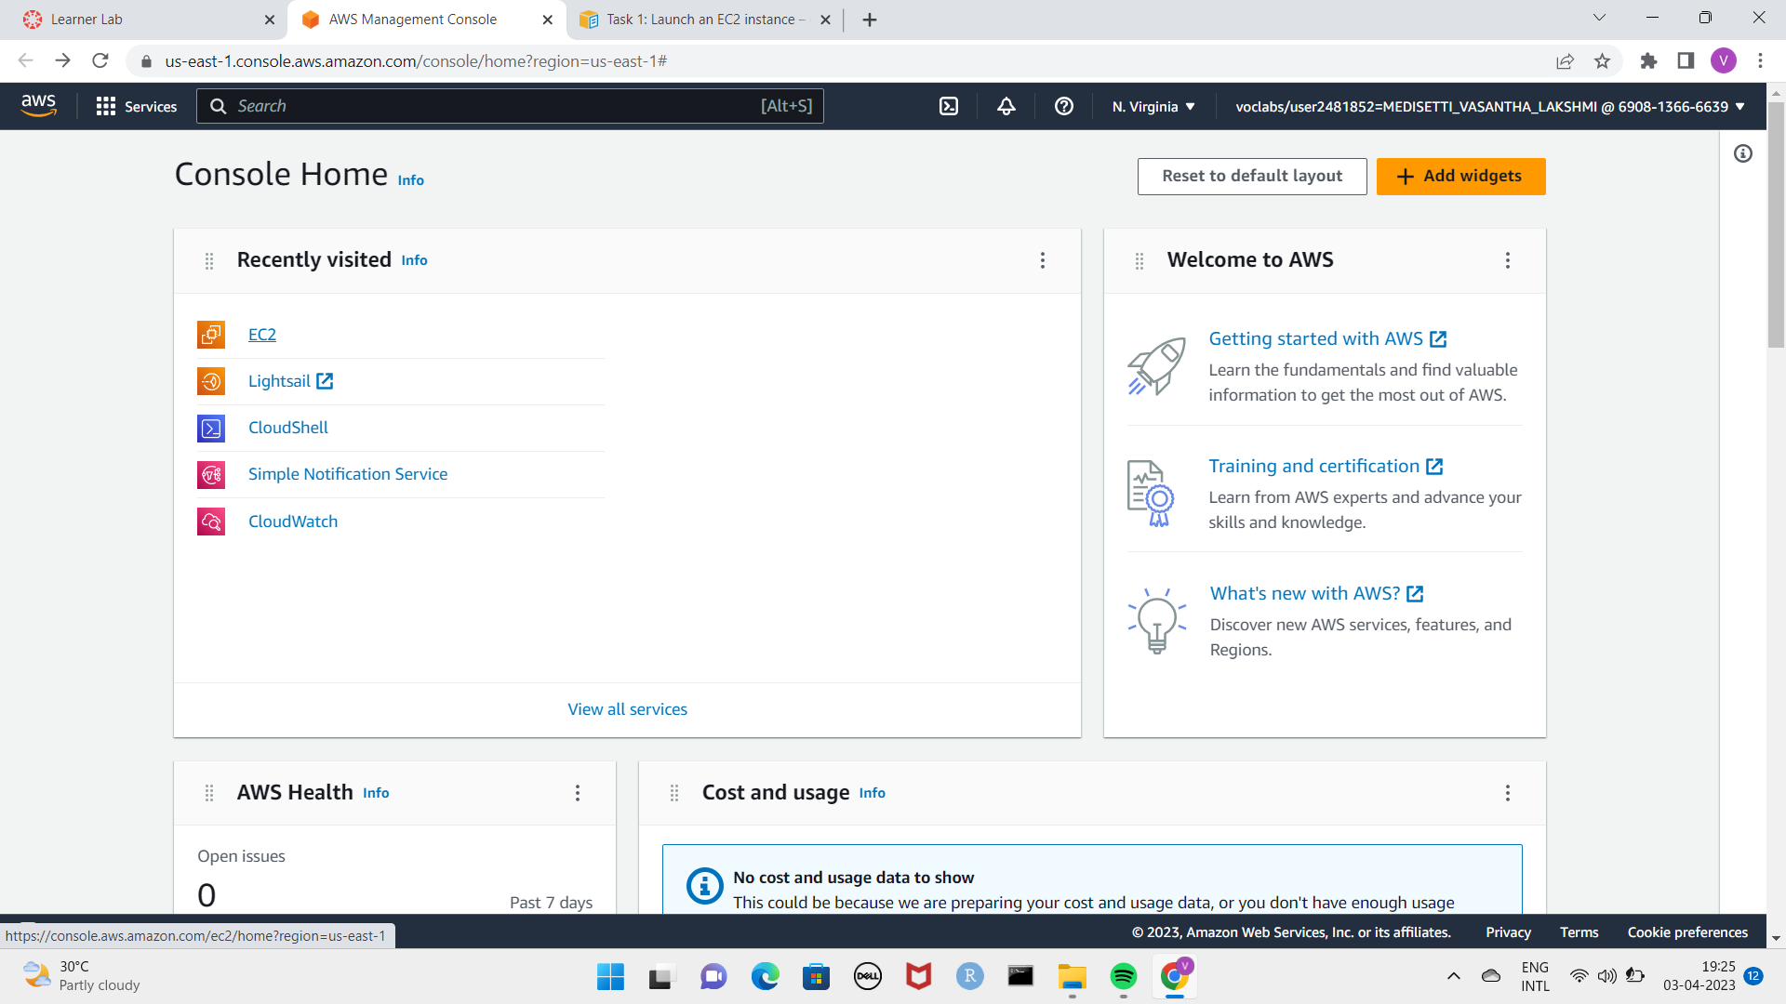
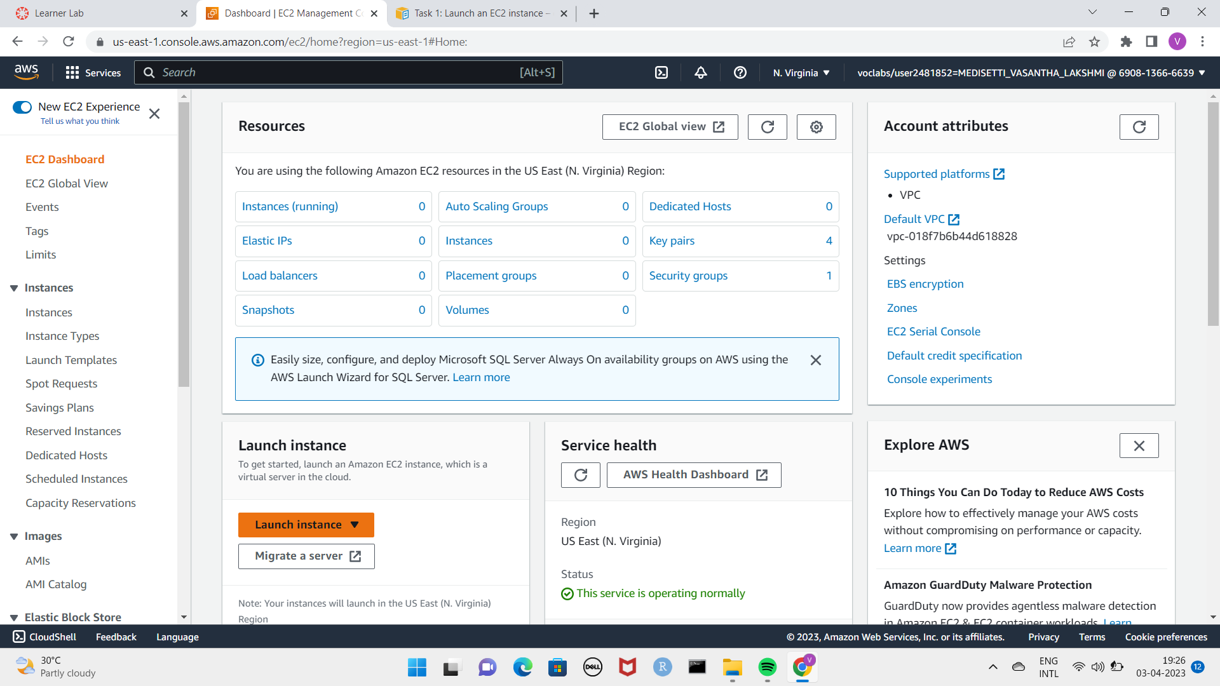
Click on launch instance to create an instance.

Slide 4
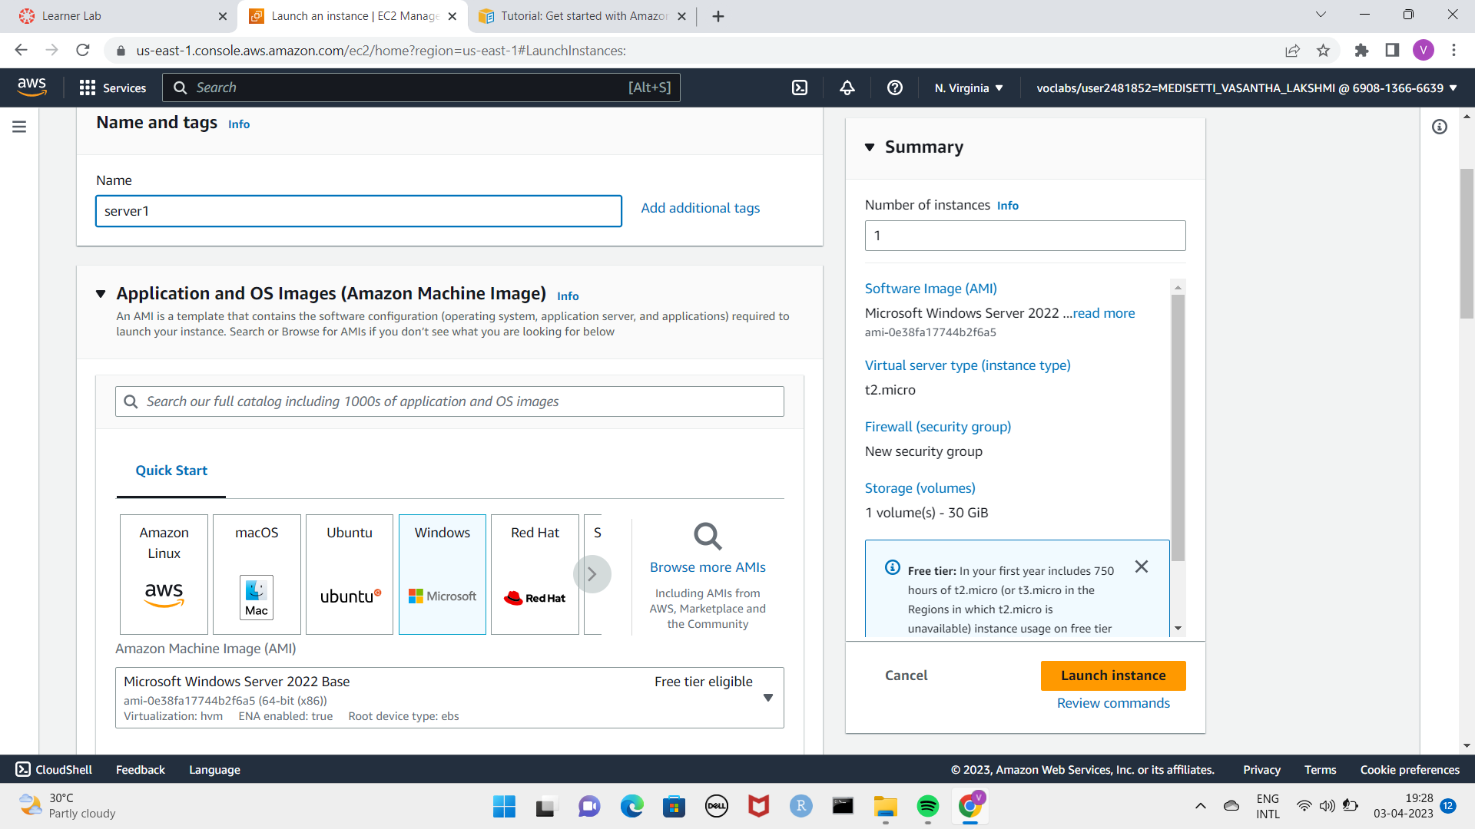
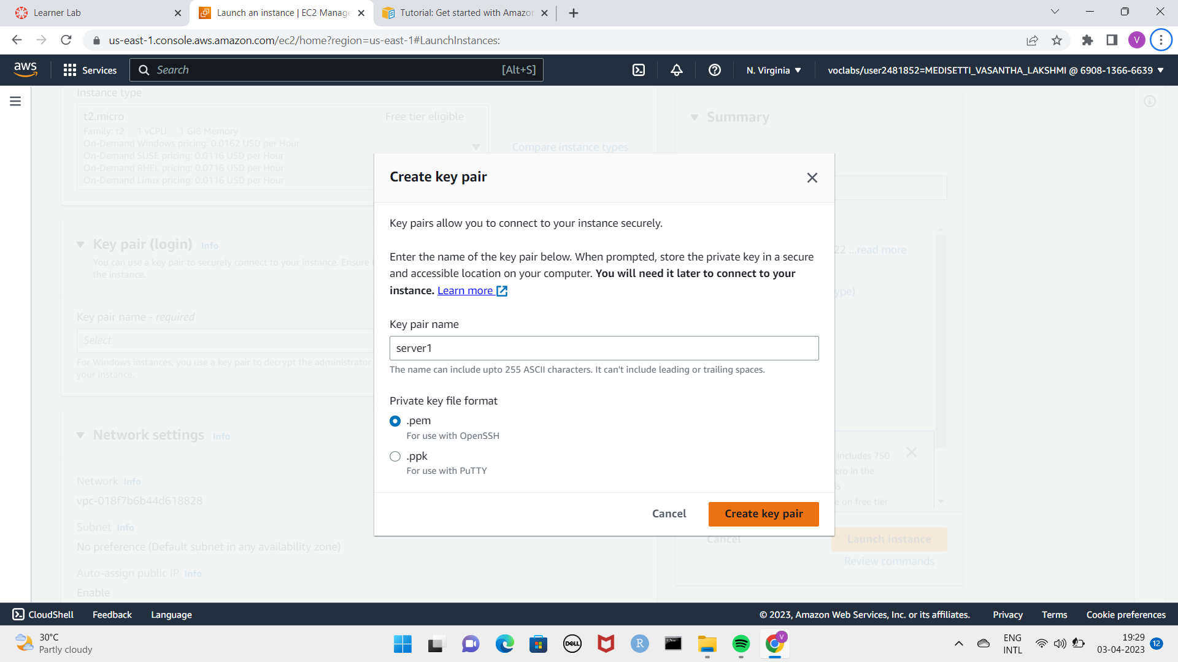
A new page will appear there we have give name for the server and then we have select the server of your choice. I have selected windows server .check the instance type to be in t3.micro
And we see to create key value pair give a name of your choics the file format can be either .pem or .ppk(it requires putty to be installed) I have selected pem .a pem will be downloded. Click on launch instance

Slide 5
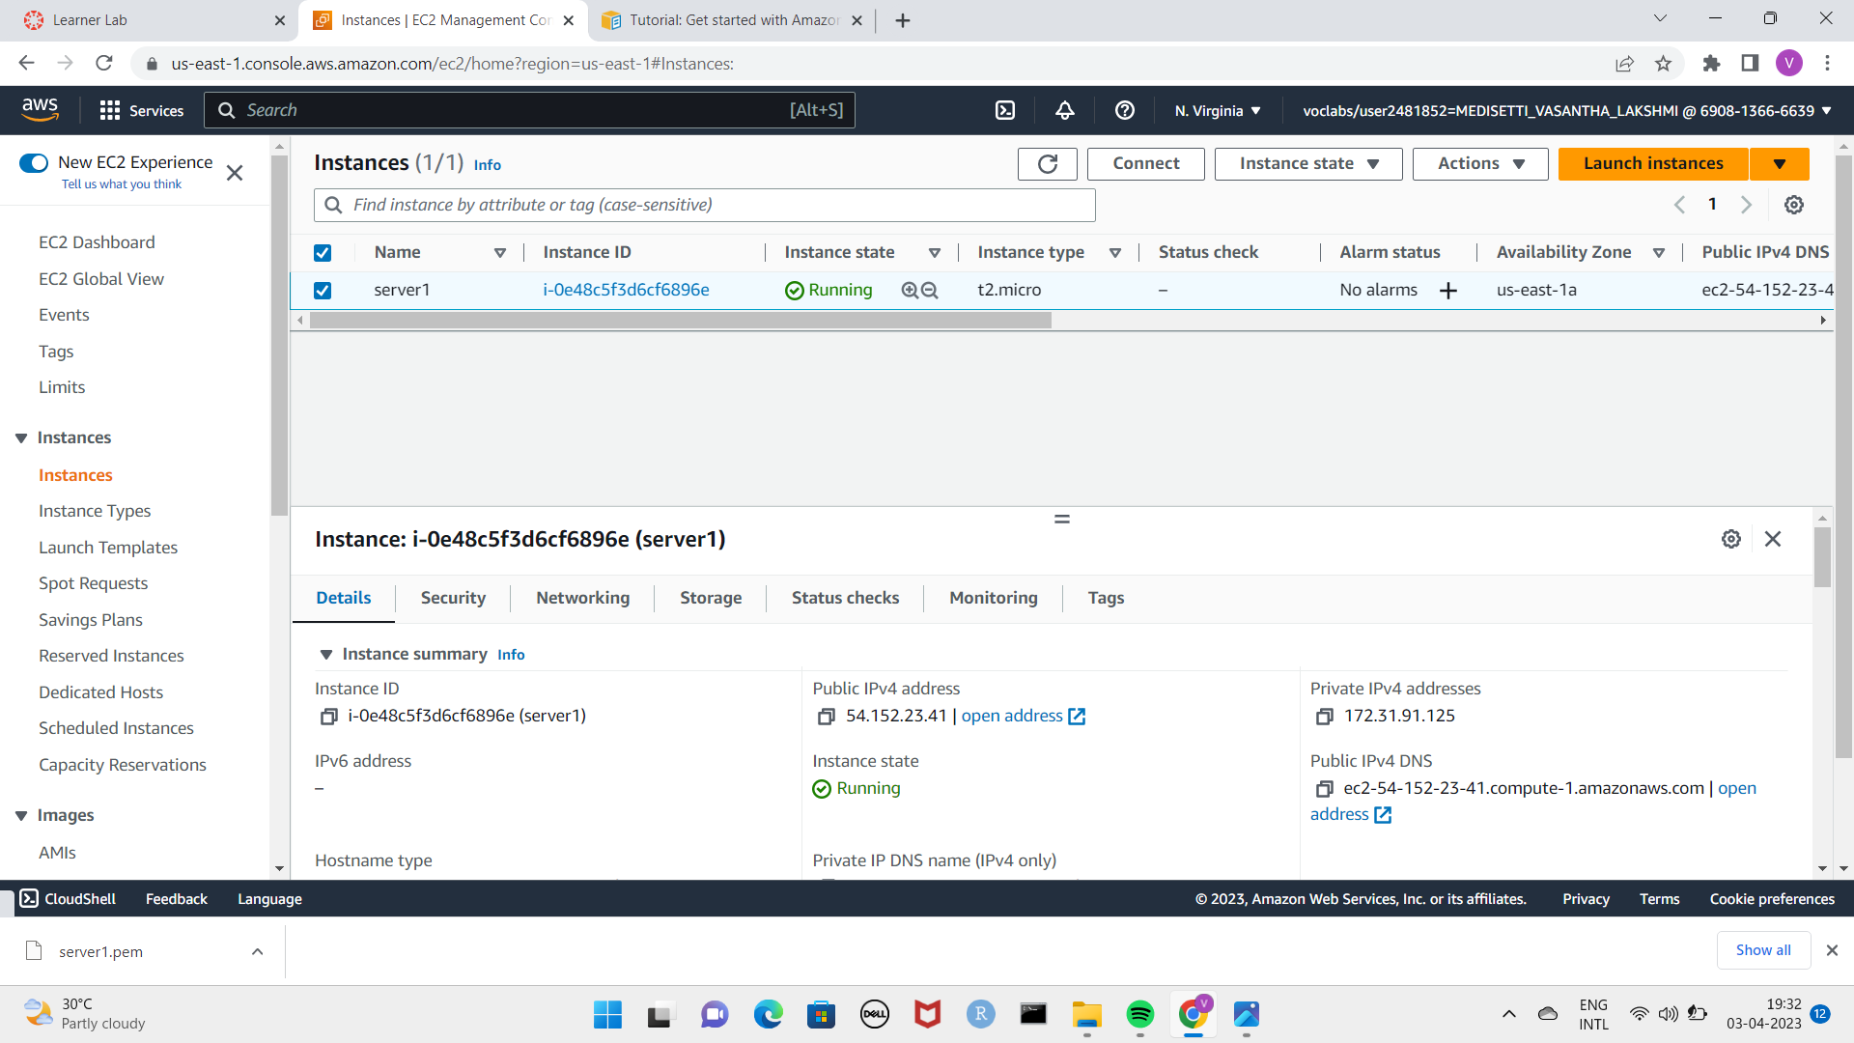
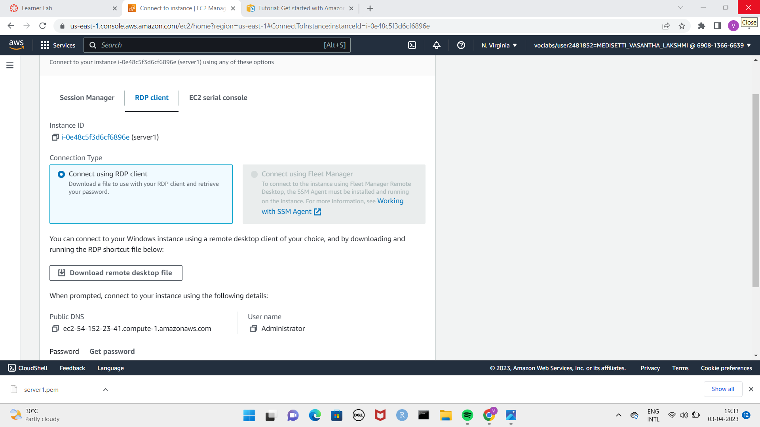
Go to instances in which the menu has given the left side of the screen .Select the instance and click on connect to connect the instance to another server which I have taken windows. Check the status of the server wheather it is running or not. And study the information of the corresponding instance provided.
And then go to RDP client download the remote desktop file for the next process and click on get password.

Slide 6
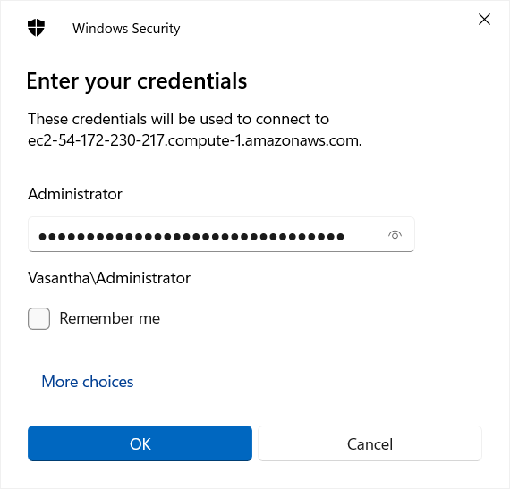
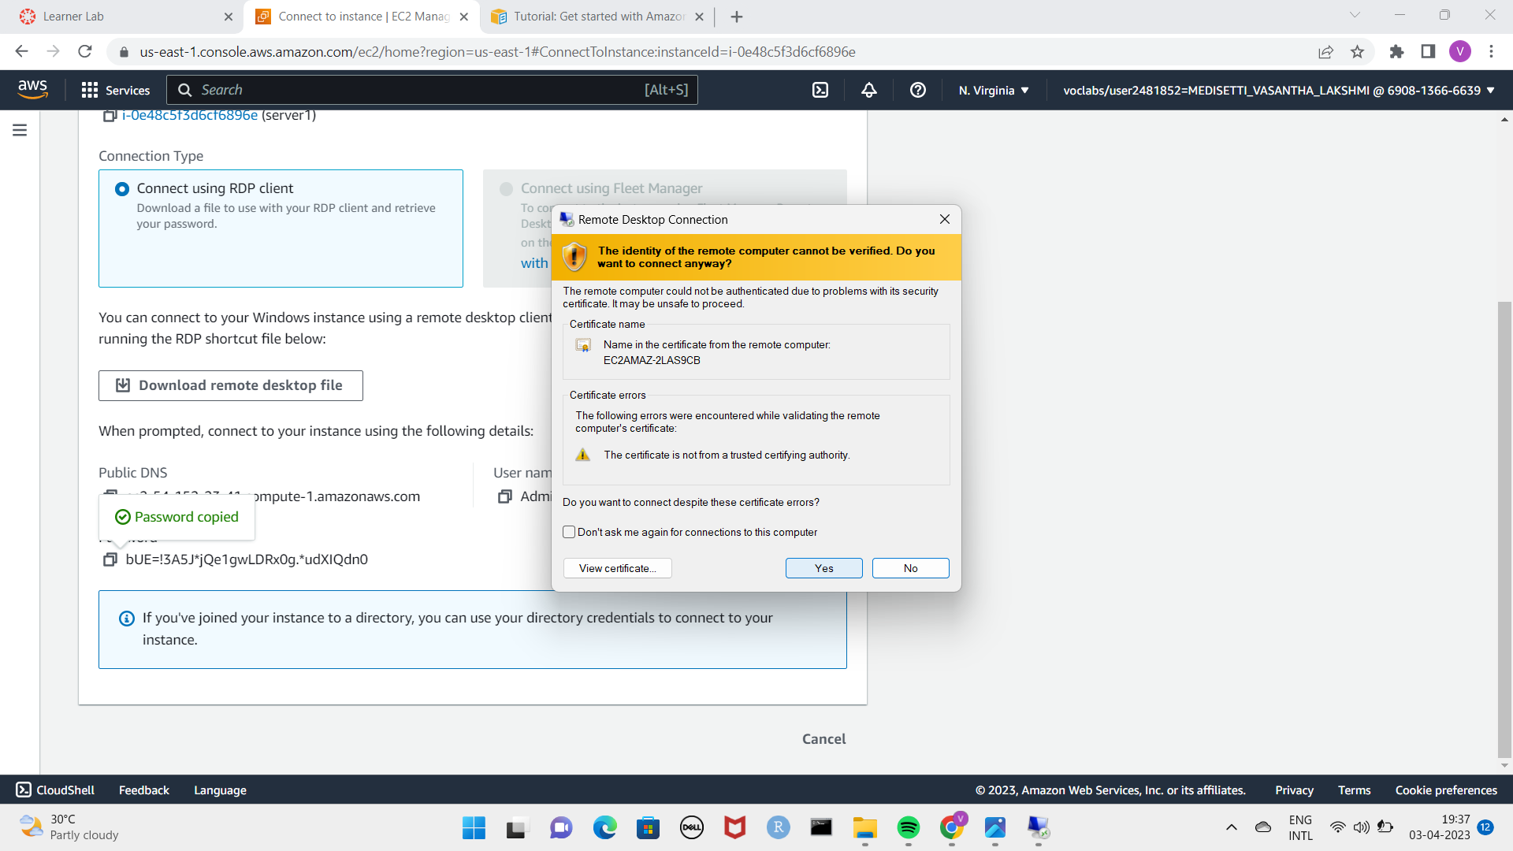
When we create a key value pair at first a file will be downloaded with the given server name upload it in the private key file and decrypt the password copy it.
Open the remote desktop file which we have downloaded if not appears on the screen go to downloads and open it . Paste the password.
Click on connect and then yes .

Slide 7
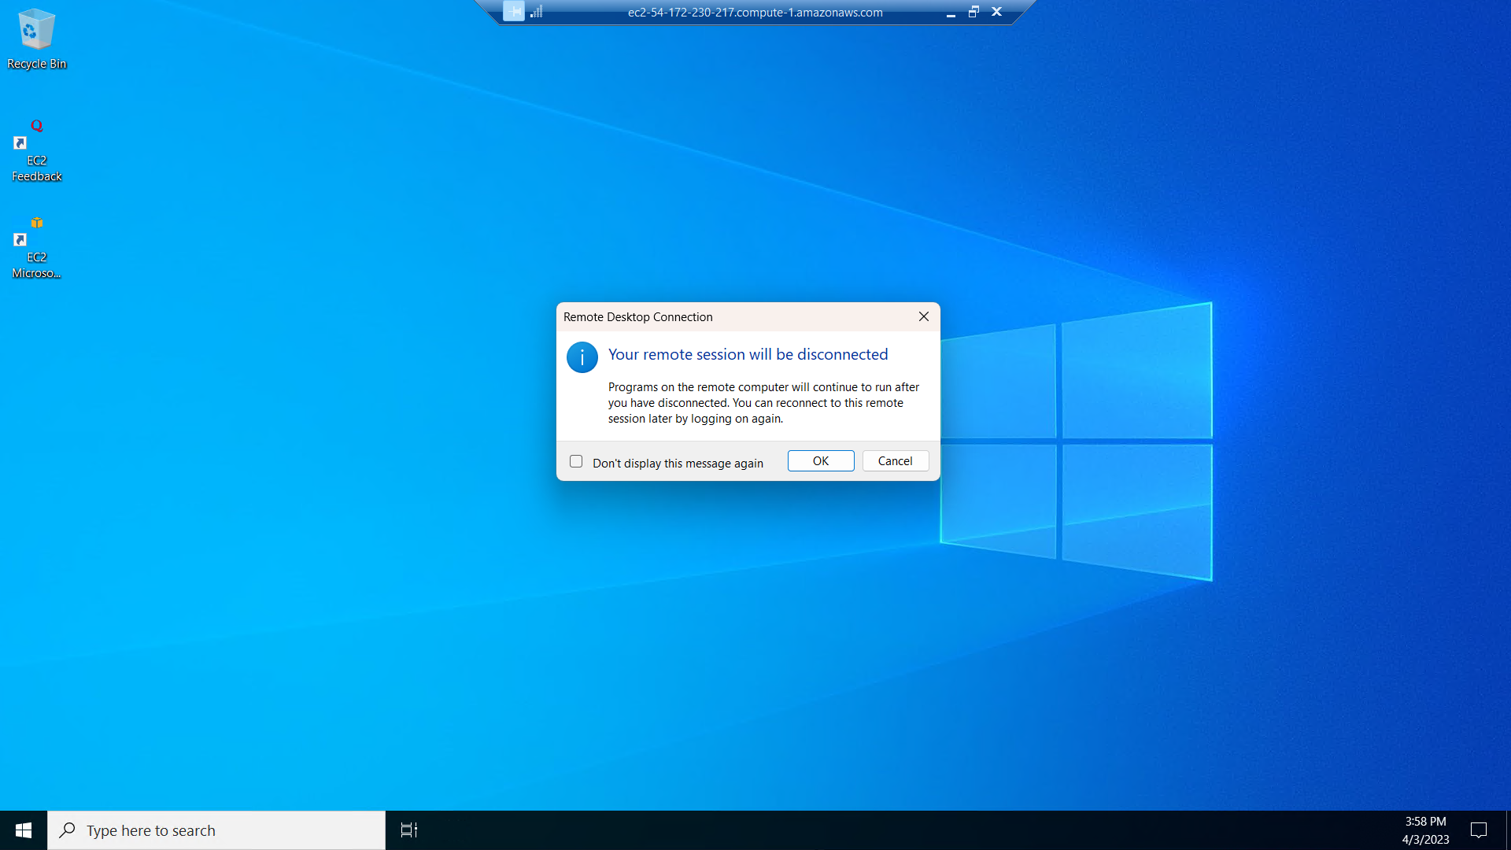
A New window will appears in which the EC2 instance is connected and close the window .
In the instances click on actions and stop the instance after that click on terminate the instance it delete the instance permanently.
And finally end the lab .

Slide 8
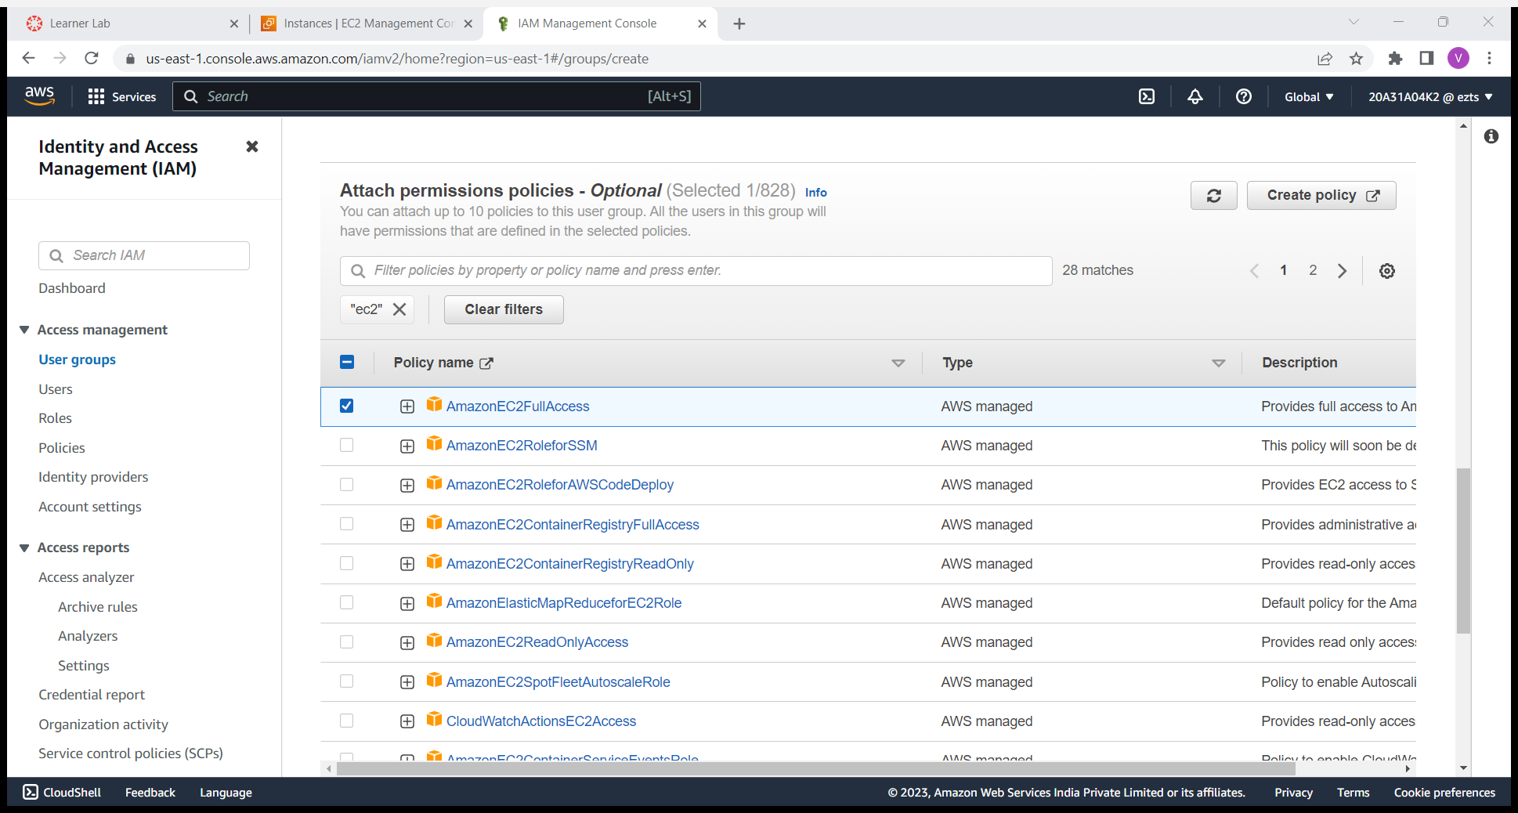
AWS IAM(IDENTITY AND ACESS MANAGEMENT):
Login in to the aws academy start lab perform the lab by given insructions and go to AWS management console search for IAM service .
Go to groups appears on the left side menu and then click on create group ,give a group name of your choice.
Select permission policy of your choice I have selected EC2 fill access means it will allow users of the group to access anything. And then click on create group.
And then add users to the group we can add many no.of users to the group which we have created.give the names for the users and click on the check and then select create IAM user.
If you want to create a new password give custom password or other wise leave it as autogenerate the pass and if you want to change the password for ever sign leave the tick mark or remove it as shown in the picture below

Slide 9
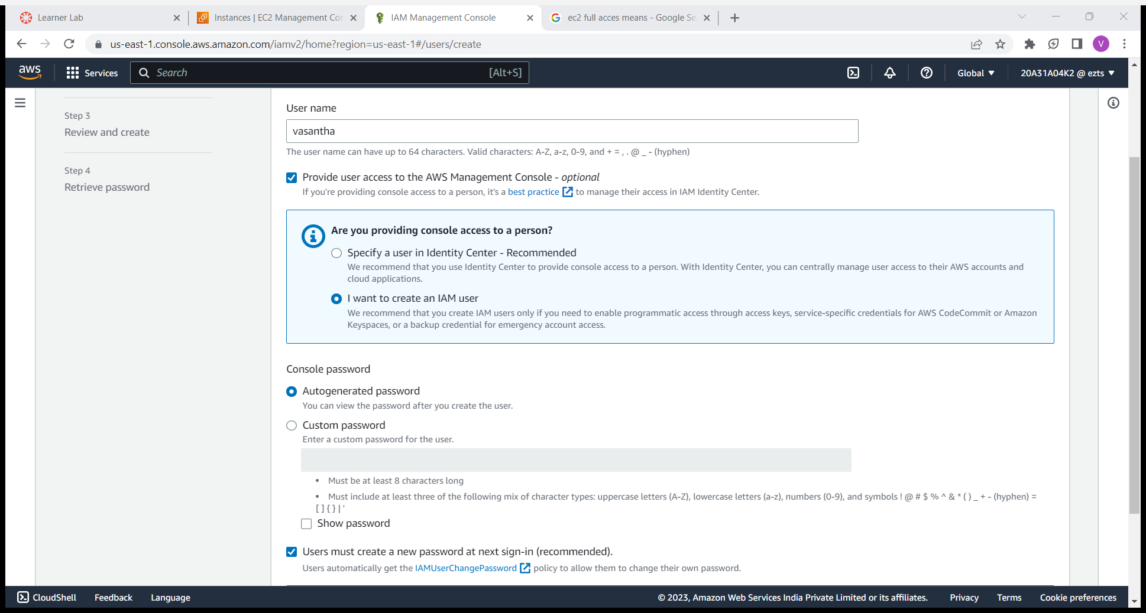
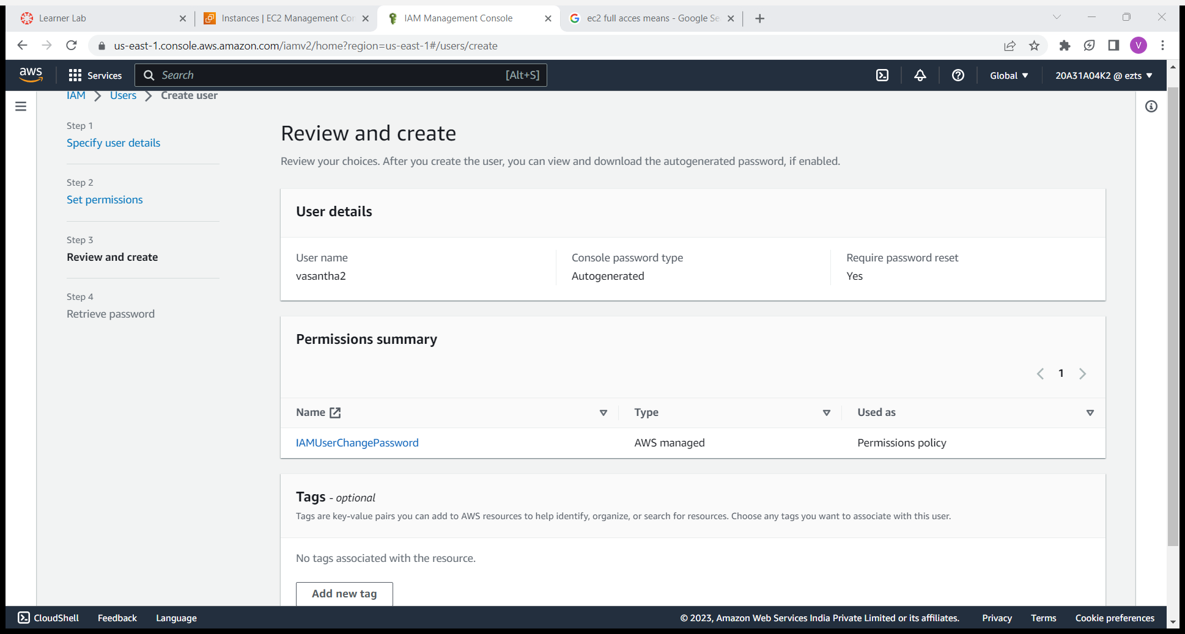
Click on next and then the new page will appears with the user information and permissions.

Slide 10
Click on create user you will get the login details if we want to check it go to aws academy and login with the created credentials we have first logout the before account.
After that click on return to users list select the users which we want to delete and click on delete.
And then go to groups and sElect the group and delete it .
Go to the lab and end the lab.

Slide 11
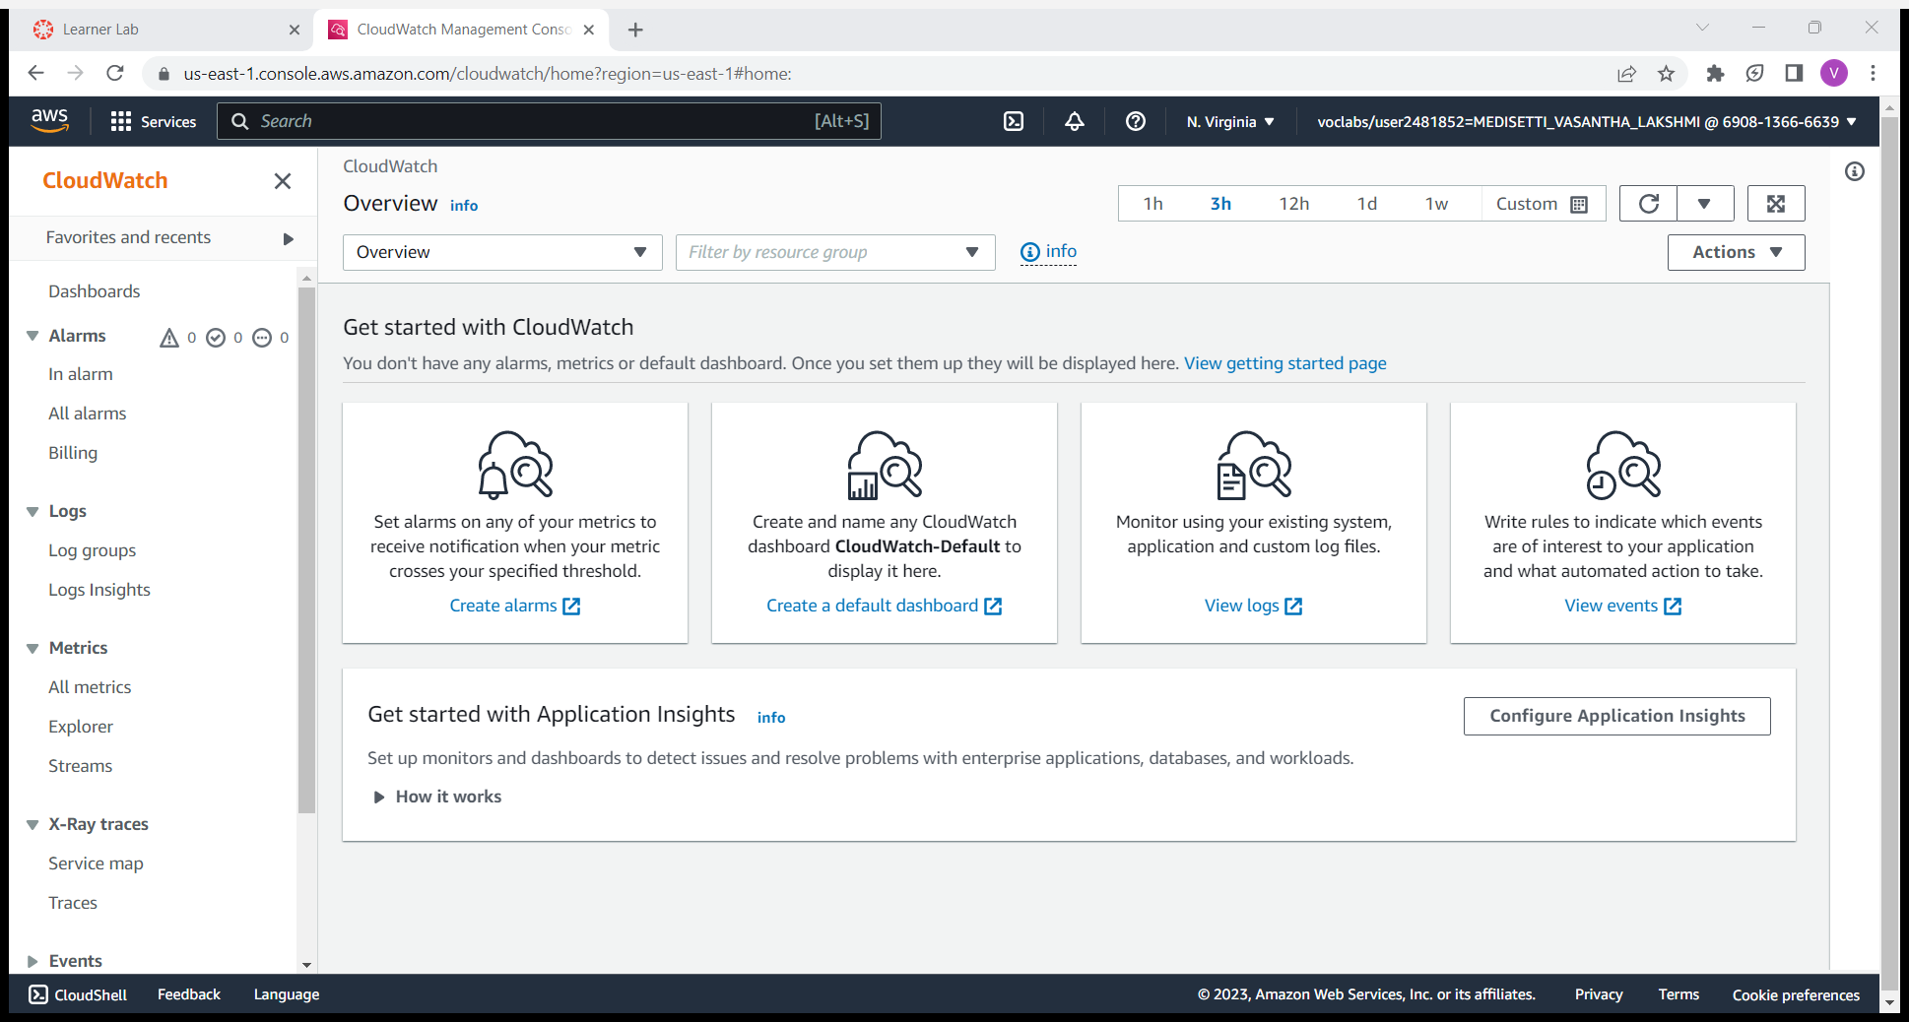
Cloud watch
It is used to set alarms and metrics for billing or any others purpose to get alerts for mail when it reaches the given permissions.
For that we have perform a lab login to the AWS academy start the lab by following the given instructions .
Open the AWS management console and search for cloud watch if not appears on the page.
To set alaram for billing select on billing and click on create alarm.
Give metric name as billing Change the currency into rupee check the threshold type, define the alarm condition and threshold value which must be a number click on next.

Slide 12
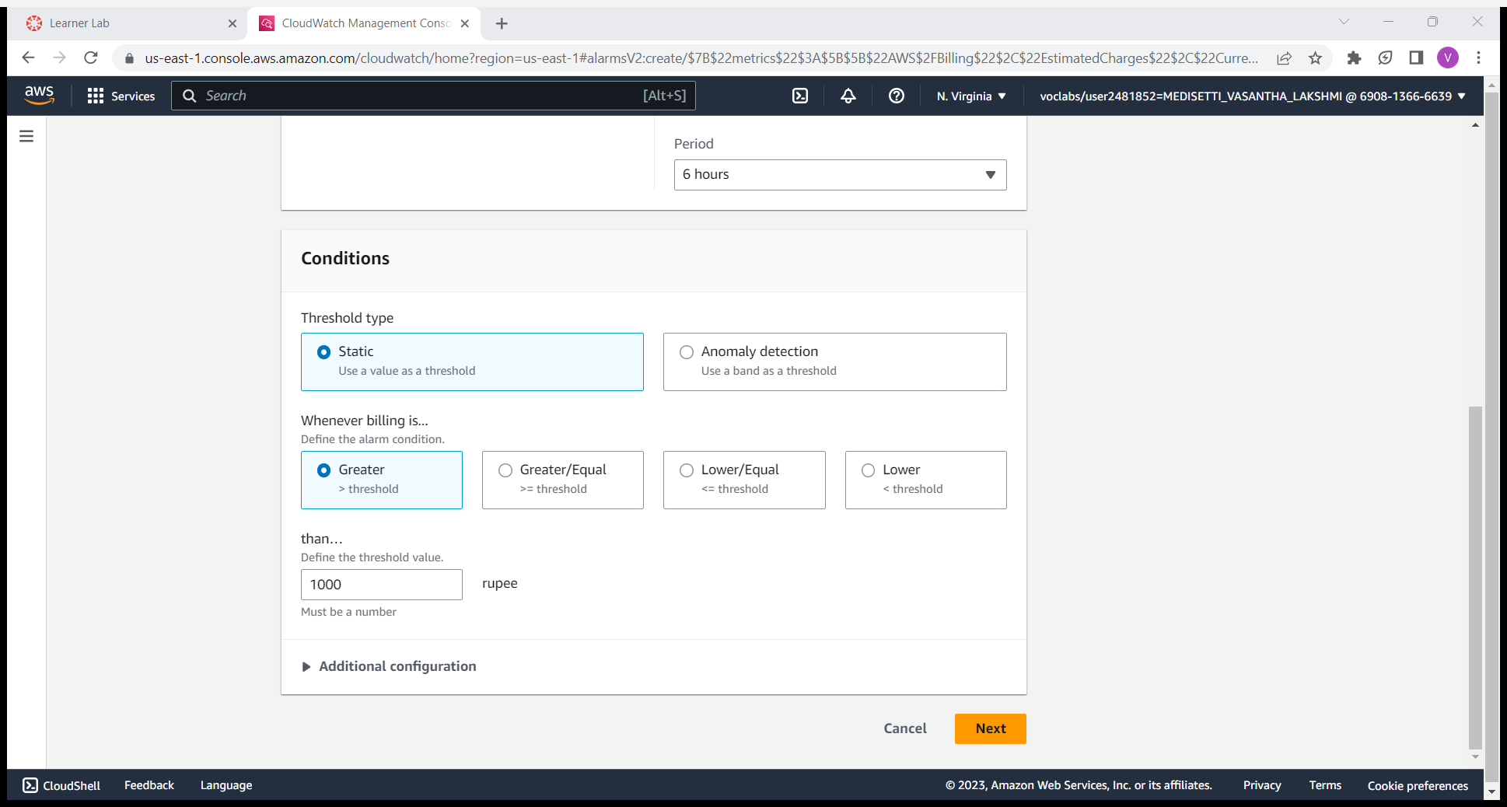
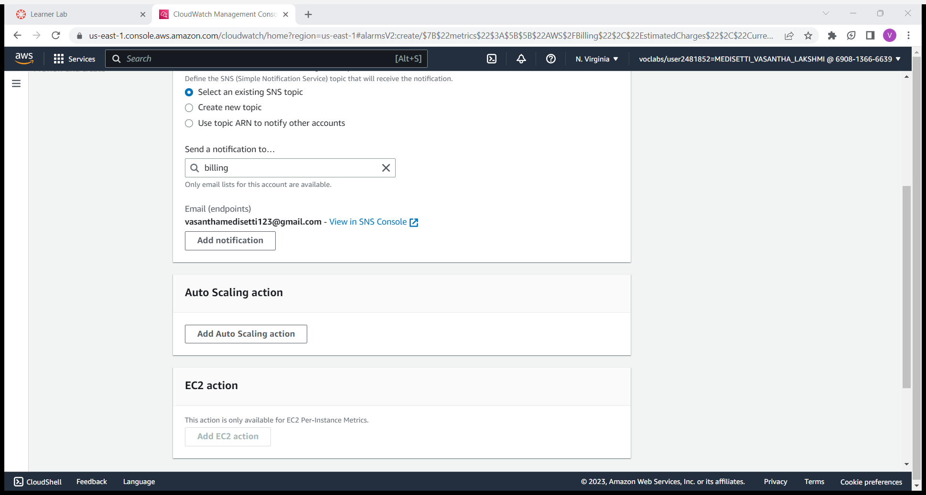
Define alaram state and set the notification on the particular topic which you have given for that you have set it in create a new topic and give the topic name of your choice and give the email address for which the notification have to be send.
Click on next and give alarm name select on create alaram ,alaram is created the notification is sent to given email and delete it end the lab.

Slide 13
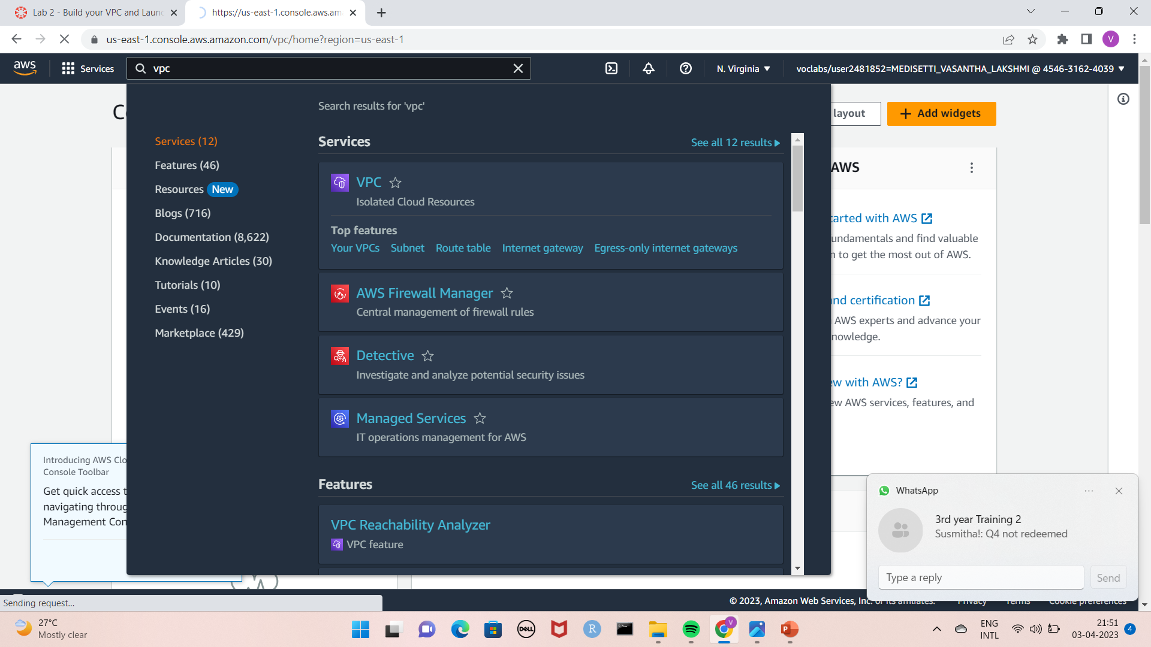
AWS VPC(Virtual private cloud)
To launch a VPC login into the AWS academy account and choose the cloud foundations we will find 10 modules select module no.5 to build and launch a web server.
Click on start lab by following the given instructions wait until the lab status is ready and then click on AWS it will open a new tab AWS management console and search for VPC service in the search bar.
Click on VPC a page will open as shown in below figure . To create an VPC click on create VPC.

Slide 14
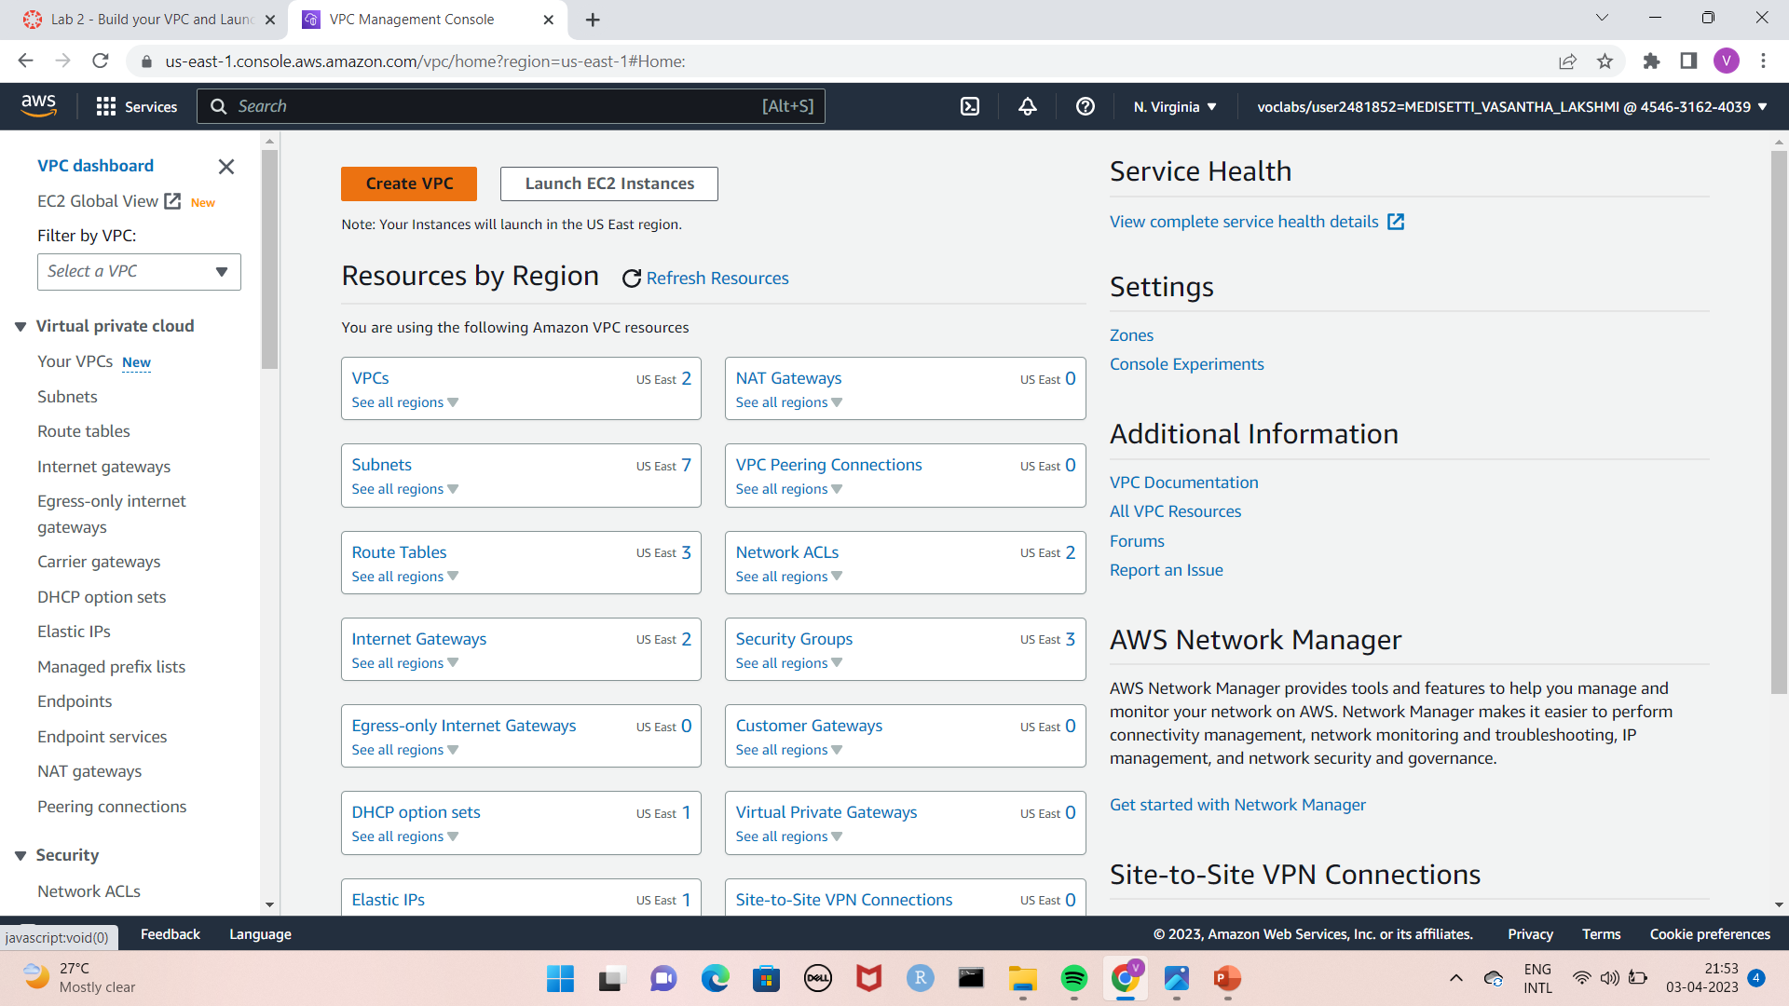
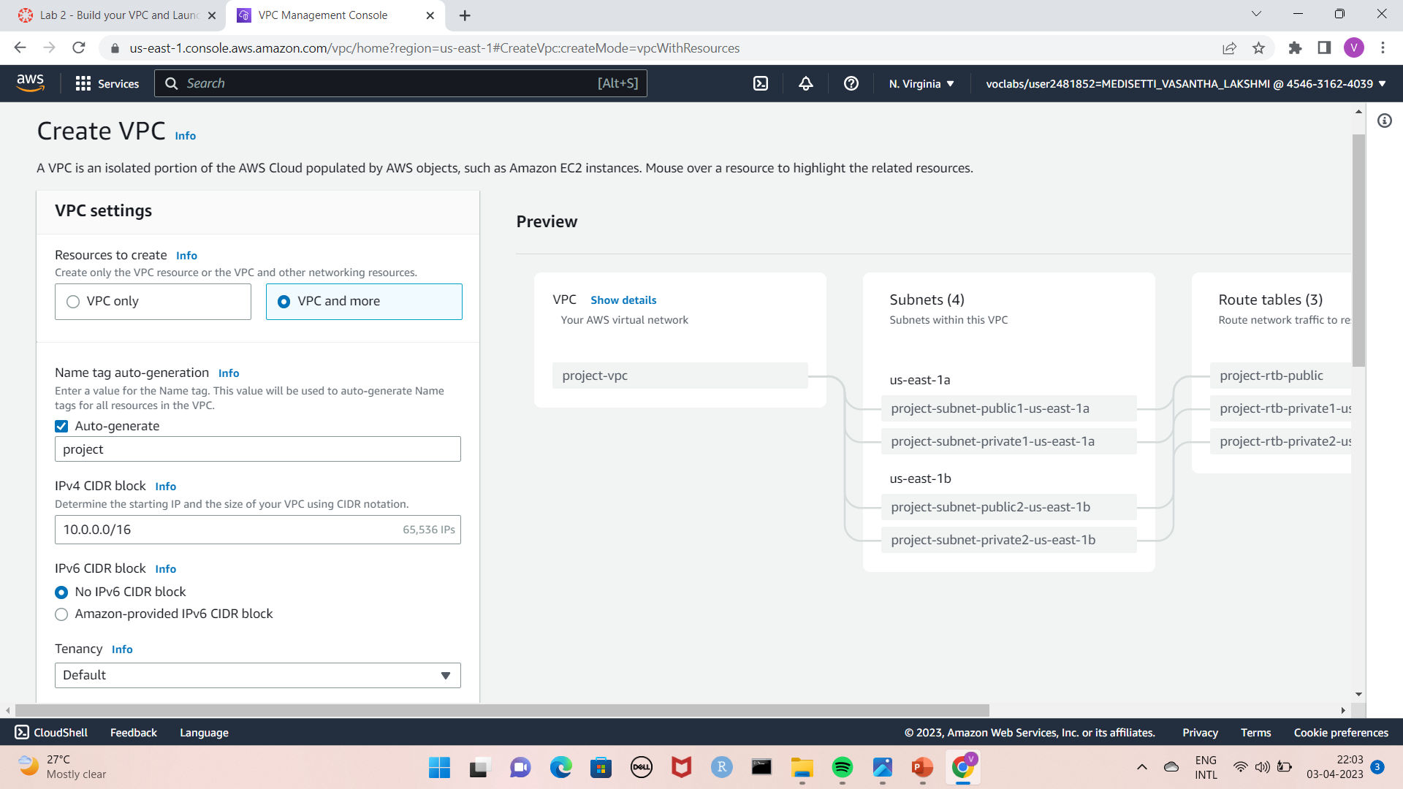
Configure VPC details VPC settings should be in VPC and more and name auto generation should be in auto generated Keep the IPv4 CIDR block set to 10.0.0.0/16

Slide 15
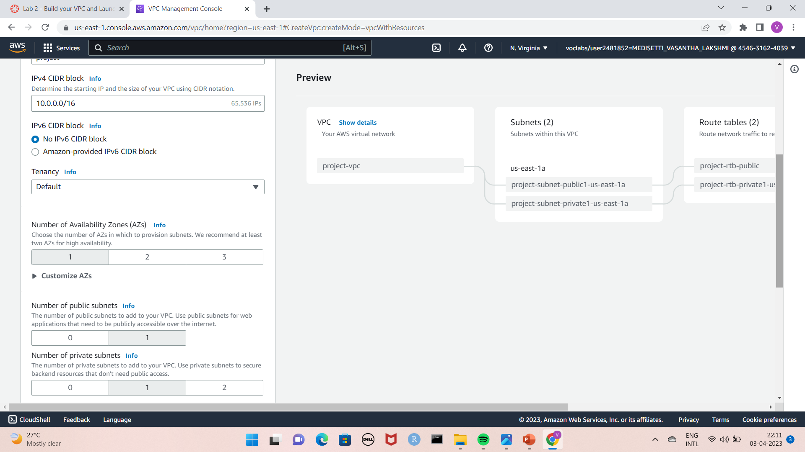
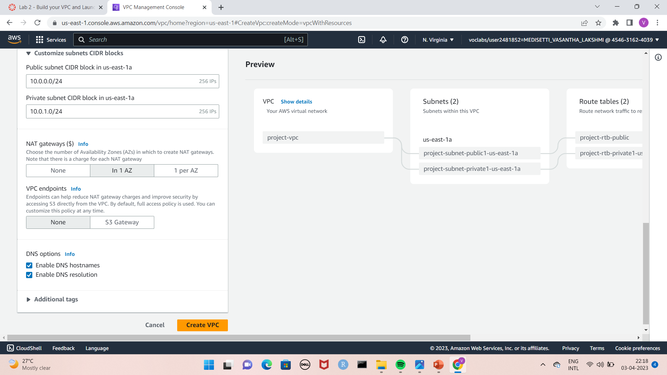
For Number of Availability Zones, public subnets, private subnets, choose 1.
Expand customized subnets CIDR blocks in which public subnet us-east 1a and private subnet us-east-1a should has IP addresses 10.0.0.0/24 and 10.0.1.0/24.
Set NAT gateways In-AZ , VPC endpoints to none and both DNS options should be enabled.

Slide 16
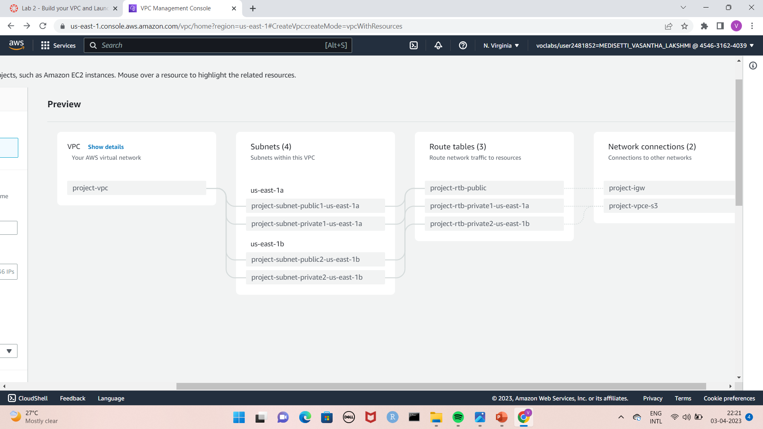
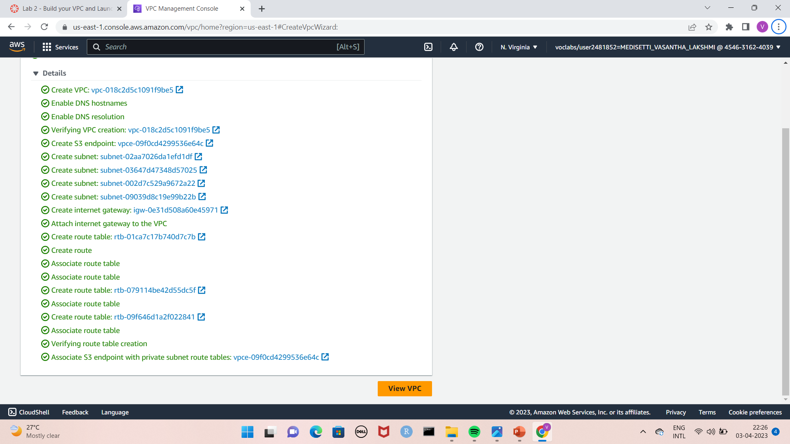
In preview we get the information of VPC as shown in the picture, click on create VPC.
Once the VPC Resources are created click on view VPC.

Slide 17
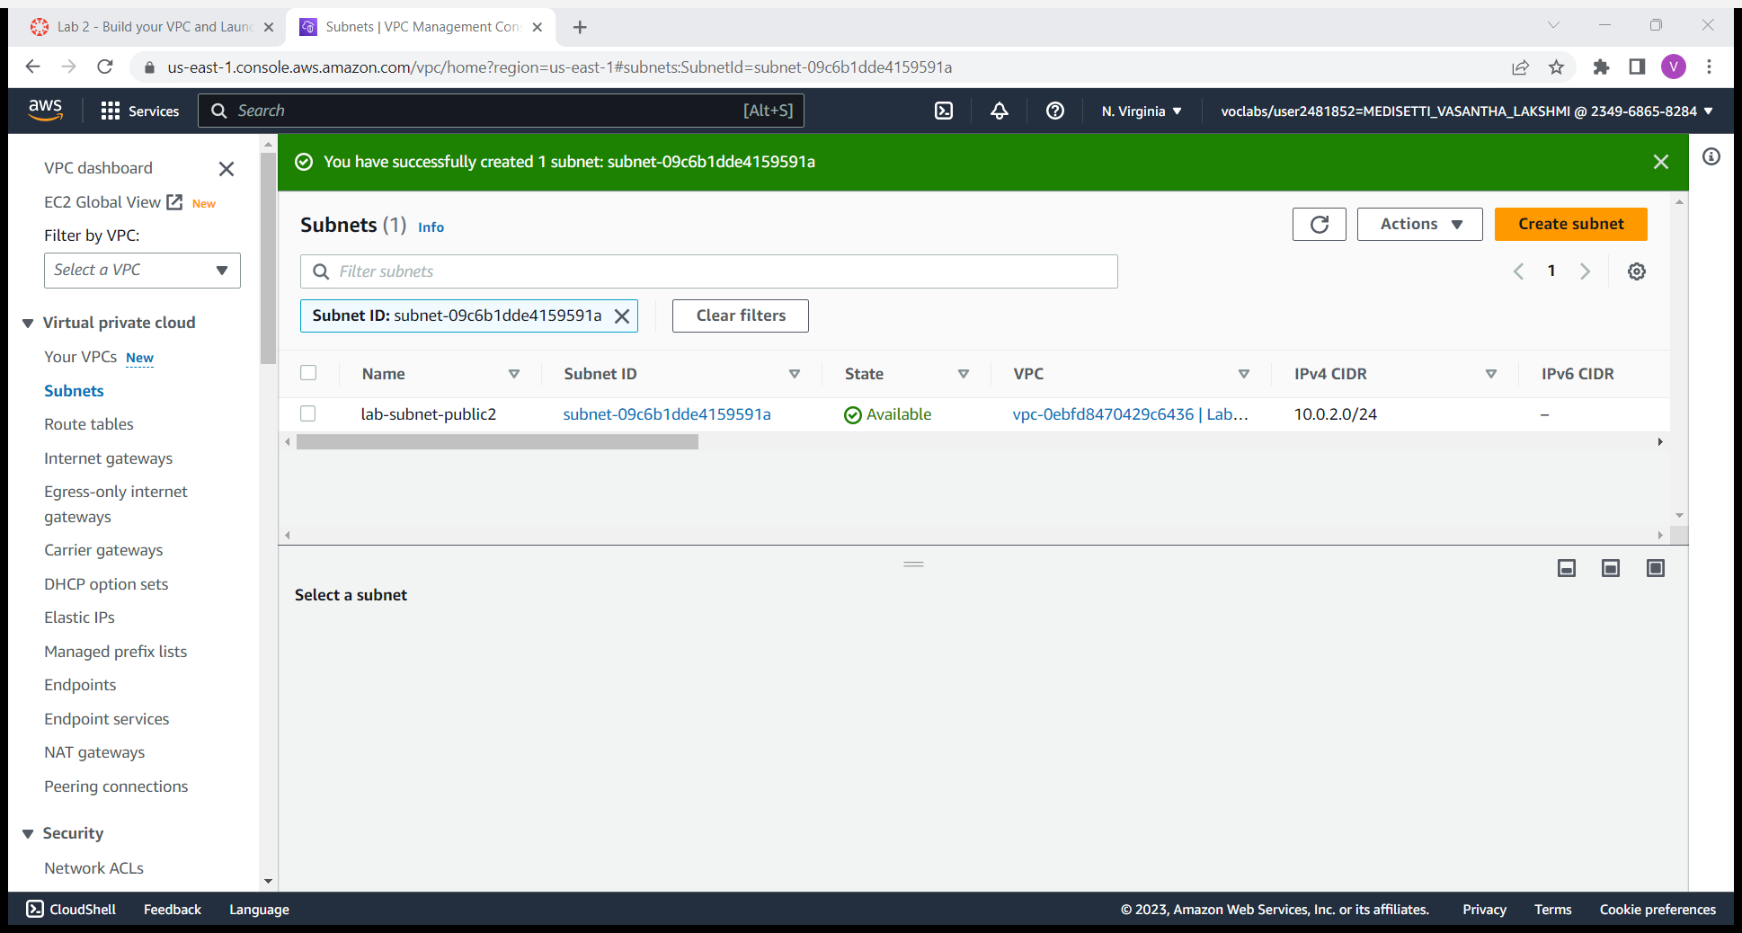
The wizard has provisioned a VPC with a public subnet and a private subnet in one Availability Zone with route tables for each subnet. It also created an Internet Gateway and a NAT Gateway.
To create additional subnet choose subnets in left side menu and click on create subnet .
Give VPC ID as lab-vpc by default and give subnet name as lab-subnet-public2.
Select the secondary availability zone as us-east-1b and give IPV4 CIDR block as 10.0.2.0./24,choose create subnet. Subnet is created.
Choose create subnet and give VPC ID as lab-vpc by default and give a subnet name as lab-subnet-private2.
Select the secondary availability zone as us-east-1b and give IPV4 CIDR block as 10.0.3.0./24,choose create subnet. Subnet is created.
In the left navigation pane, choose Route tables.
Select lab-rtb-private1-us-east-1a route table.
in lower pane choose the routes tab.

Slide 18
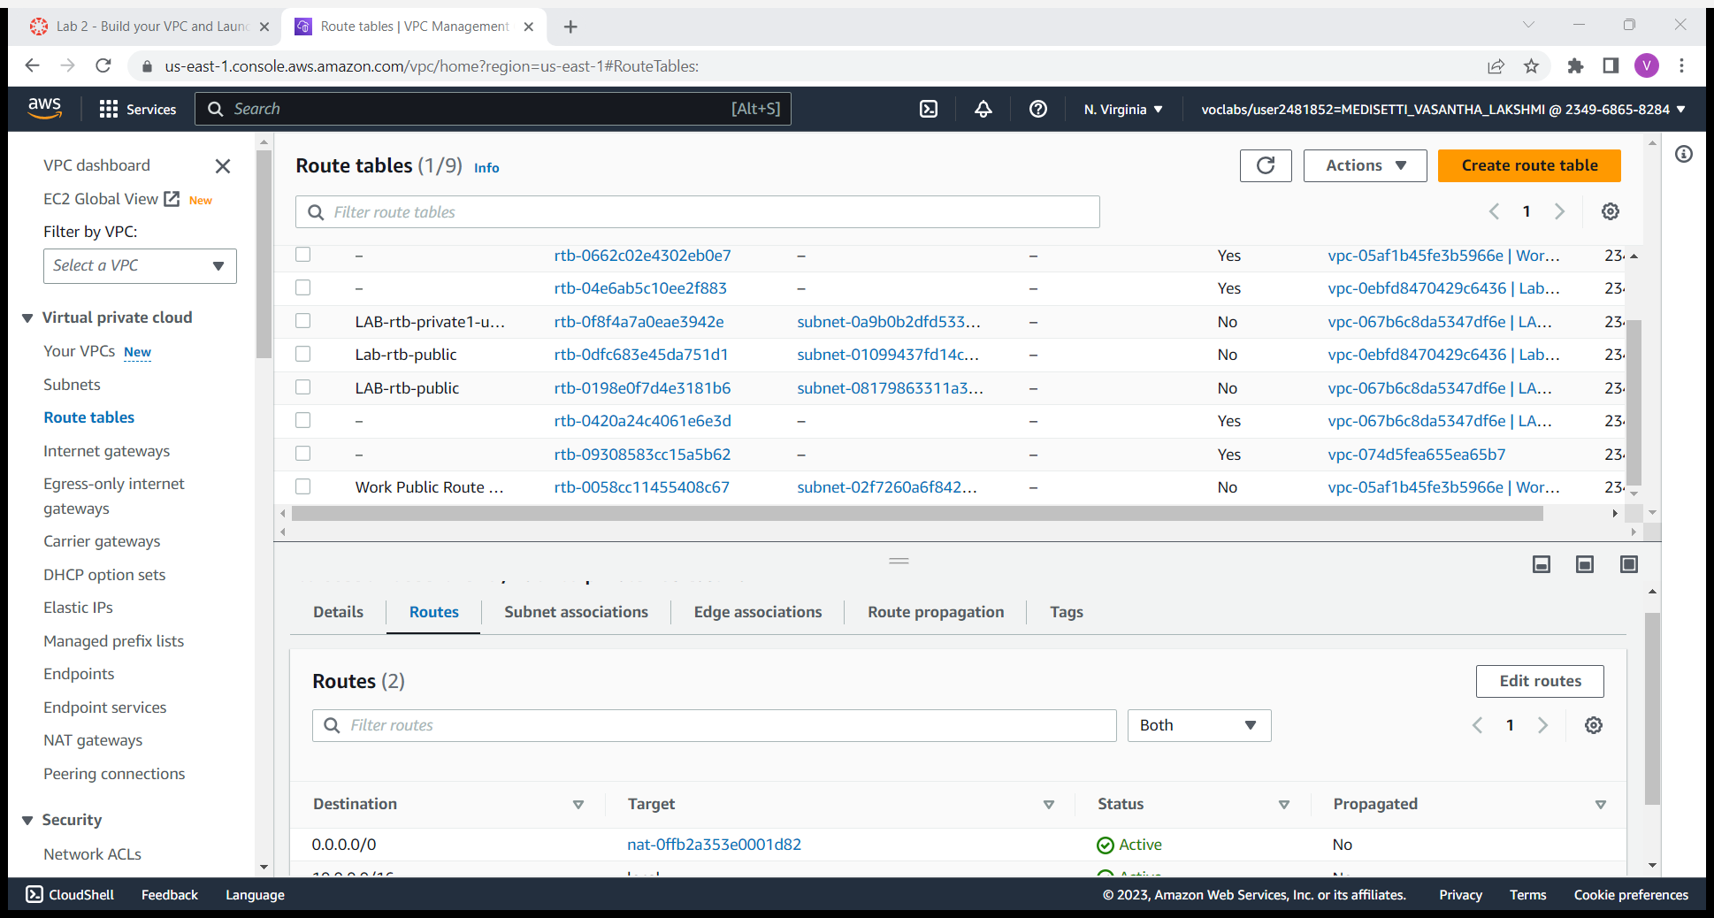
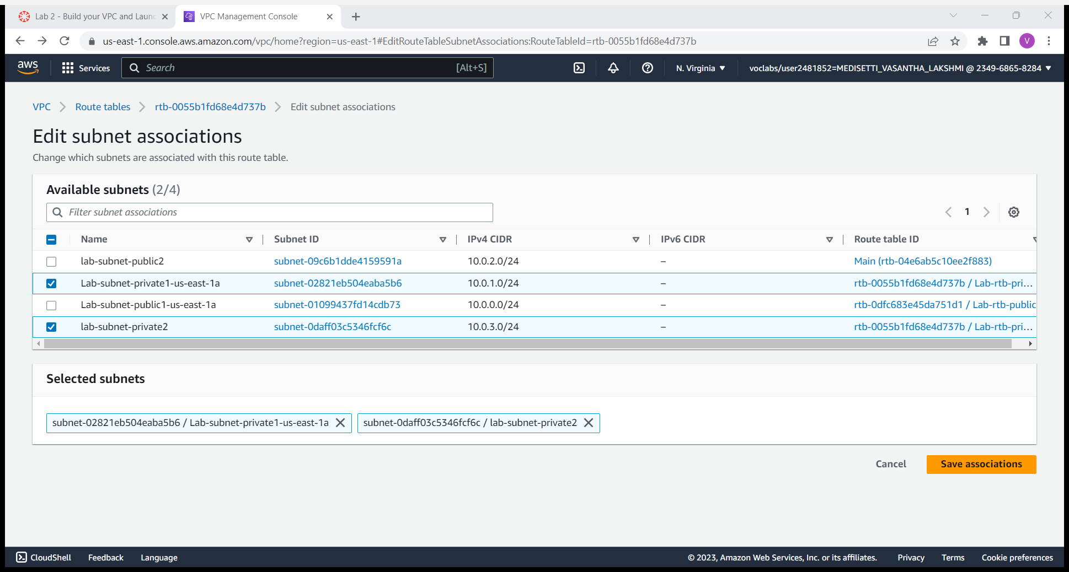
Choose the subnet associations tab. choose edit subnet associations.
Leave lab-subnet-private1-us-east-1a selected, but also select lab-subnet-private2 and click on save associations.

Slide 19
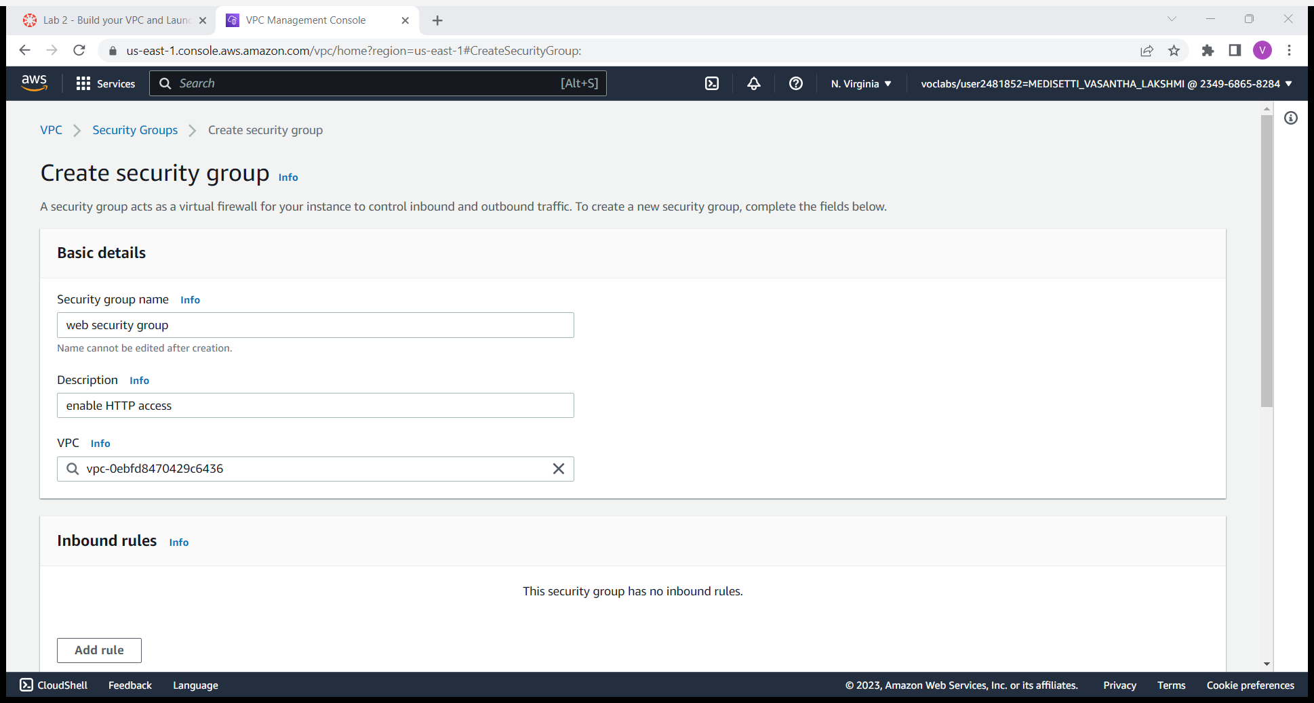
Select lab-rtb-public and click on subnet associations tab.
Leave lab-subnet-public1-us-east-1a selected, but also select lab-subnet-public2.
Choose save associations.
To create a vpc security groups choose security group in the left pane. And click on create security group.
Give security group name as web security group and description as enable HTTP access,choose lab Vpc.
In inbound pane choose add rule , and then choose HTTP , IPV4 anywhere , in description give permit web requests.

Slide 20
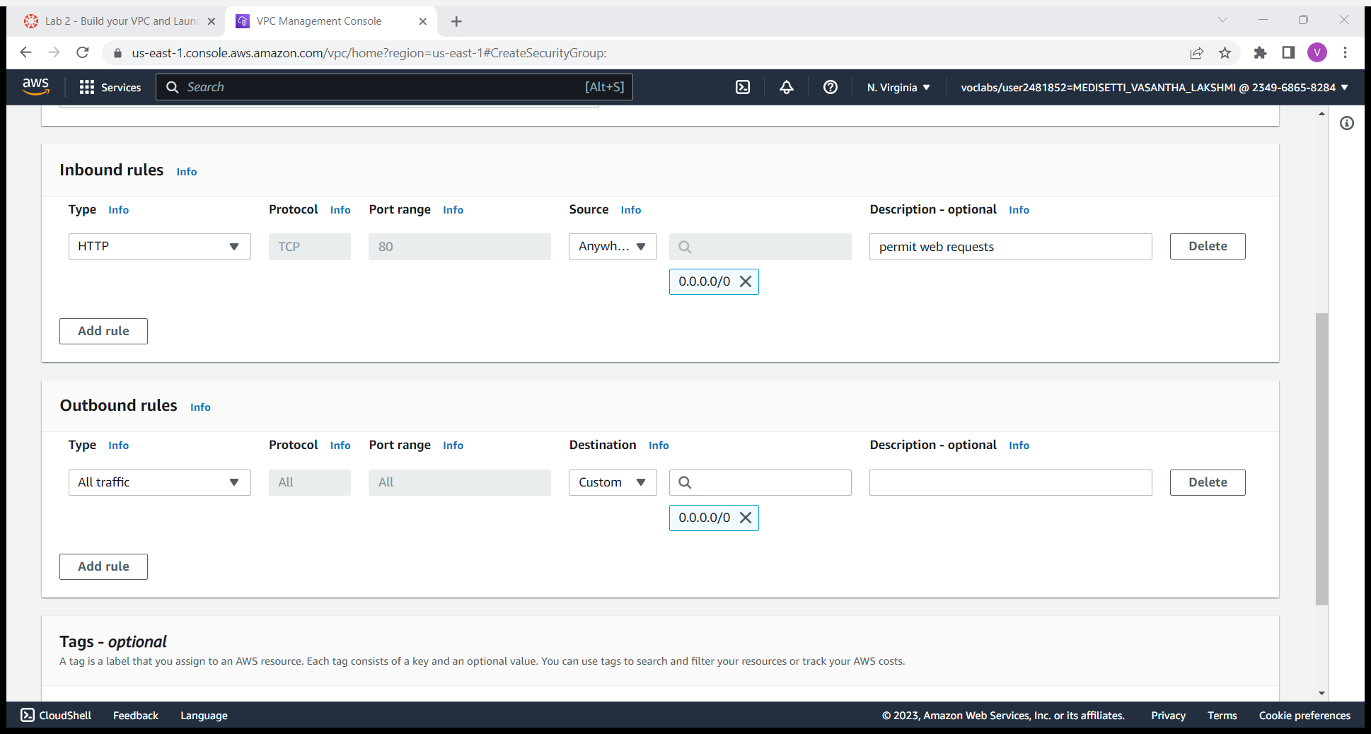
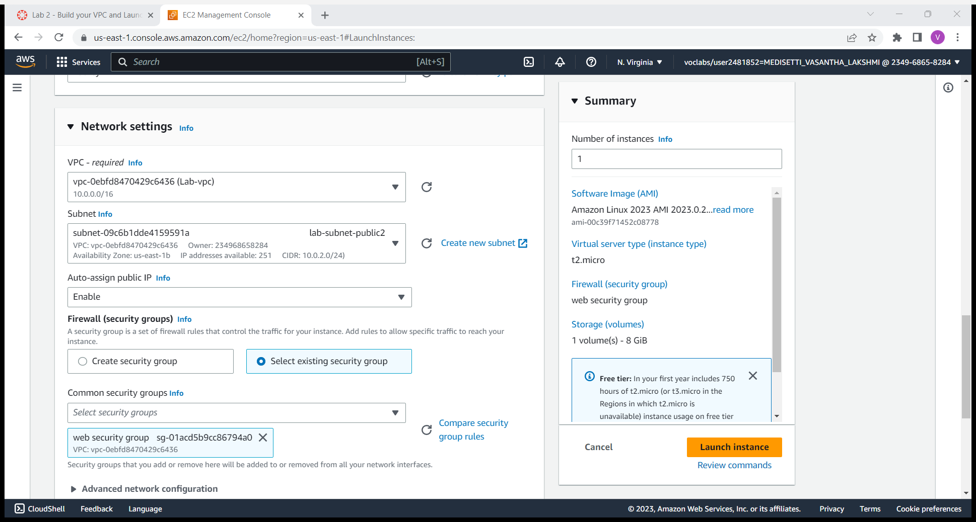
Click on create security groups.
Security groups will be created successfully.
To launch a webserver instance search for ec2 instance in search bar and follow the same steps in which we launched an EC2 instance previously.
Configure network settings choose lab vpc, lab-subnet-public2, enable auto sign public IP, select existing security group and click on websecurity group.

Slide 21
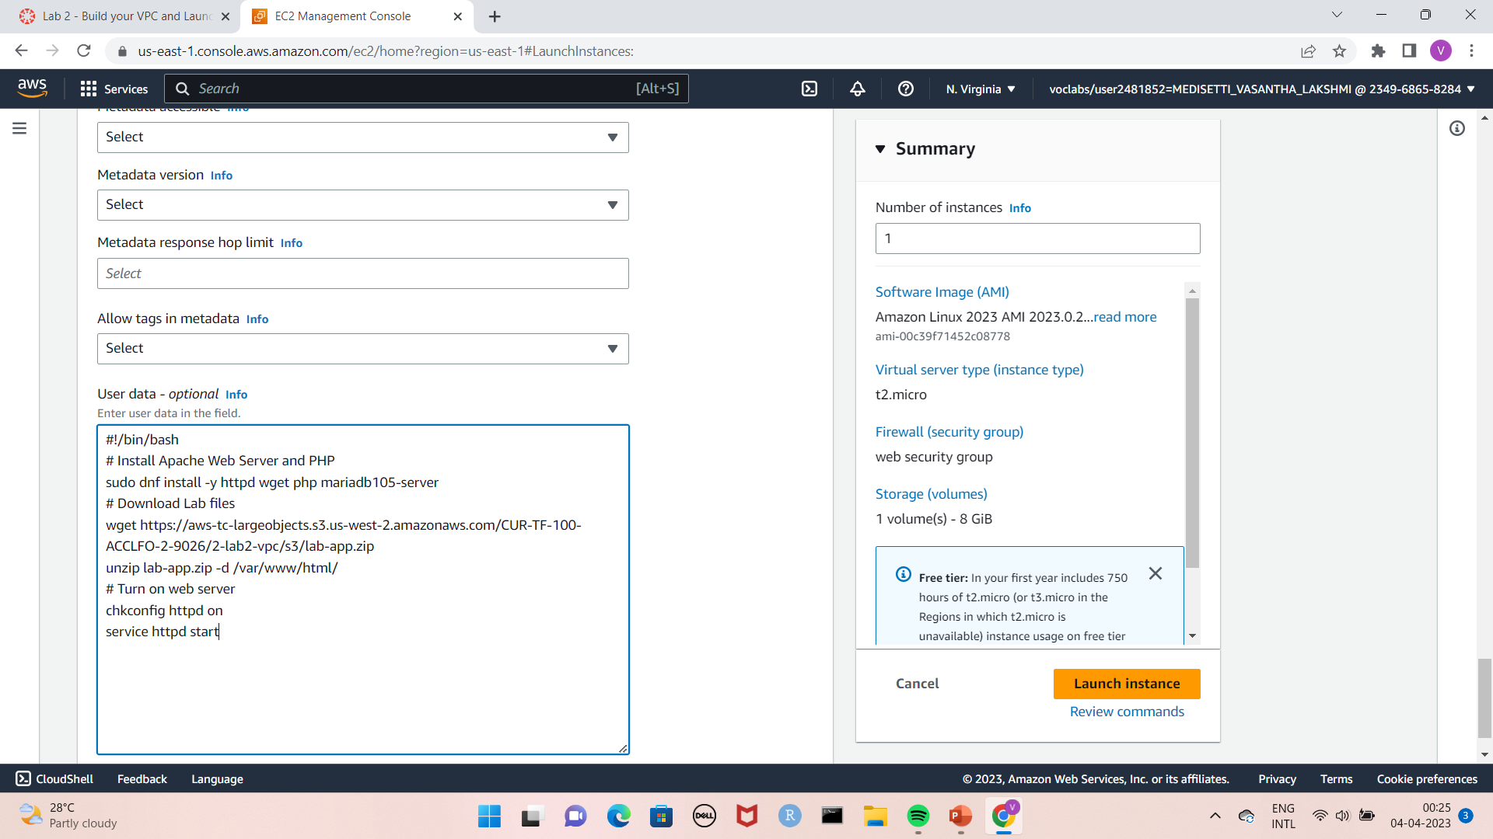
Expand advanced details and paste the below data in the user data.
Click on launch instance and go to instances and selected the webserver1.
Copy the Public IPv4 DNS value shown in the Details tab at the bottom of the page.
Paste it in a new tab and open it.
#!/bin/bash
# Install Apache Web Server and PHP
sudo dnf install -y httpd wget php mariadb105-server
# Download Lab fileswget https://aws-tc-largeobjects.s3.us-west-2.amazonaws.com/CUR-TF-100-ACCLFO-2-9026/2-lab2-vpc/s3/lab-app.zip
unzip lab-app.zip -d /var/www/html/
# Turn on web server
chkconfig httpd on
service httpd start

Slide 22
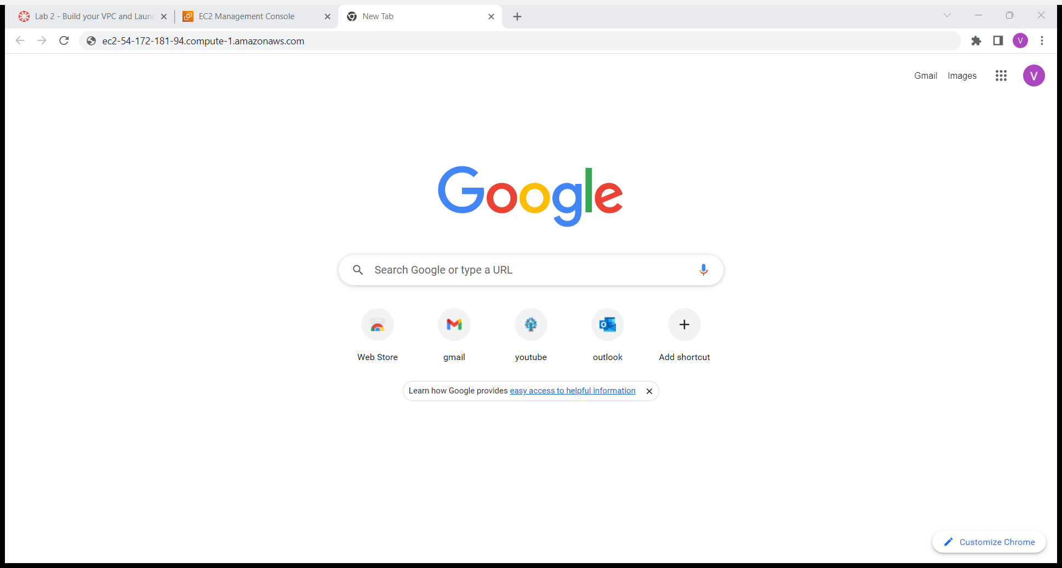
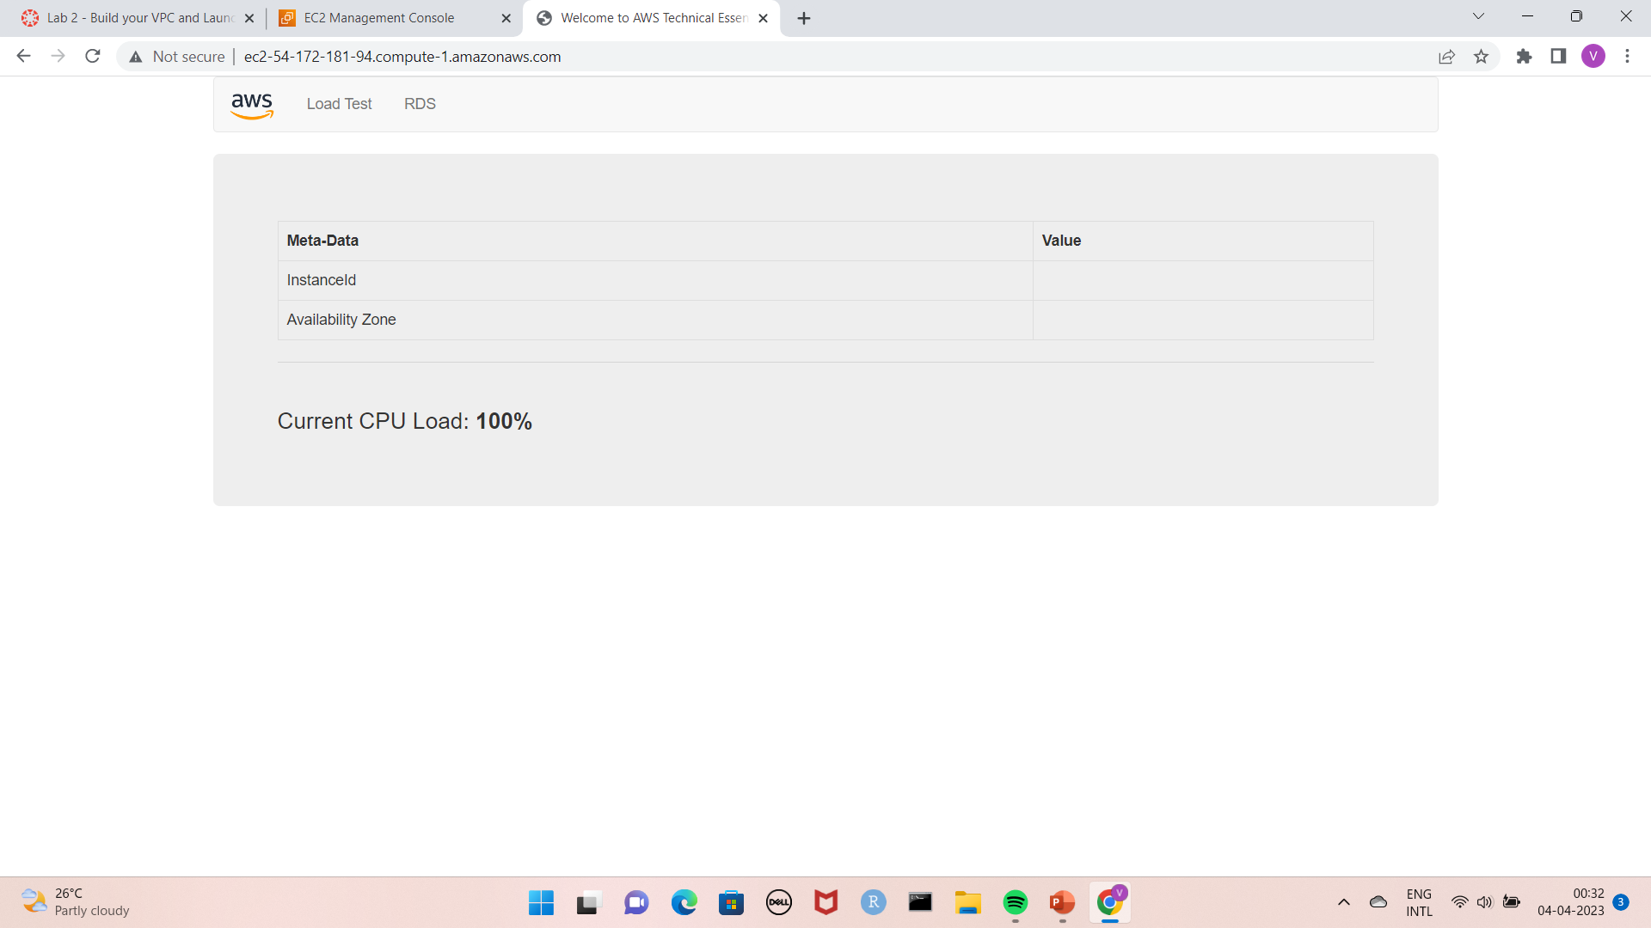
You will get page as shown the the below picture. and then end the lab.

Slide 23
Working with EBS

